Slide 1
Enterprise Systems For Management
Chapter 3
Topic : ERP Architecture

Slide 2
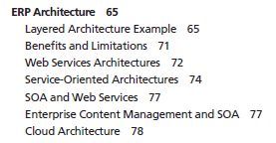

Slide 3
ERP Architecture
ERP system architecture is organized in layers or tiers to manage system complexity in order to provide scalability , reliable and flexibility.
While the servers may be centralized, the clients are usually spread across multiple locations throughout the enterprise.
You can scale the number of users from 10 to 100 layering is done at both the hardware and software environments.

Slide 4
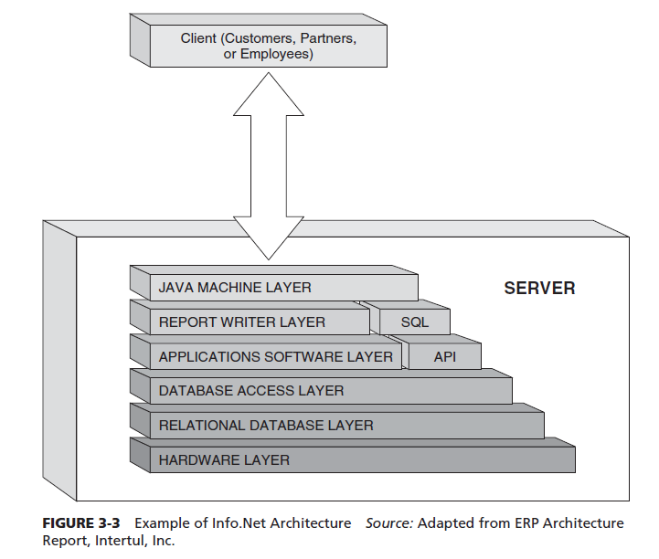
Layered Architecture Example
Info. Net architectures ,this architecture provides a Web-based user interface (i.e., user can access the applications via the Internet through a PC)

Slide 5
Data tier
The data tier focus is on the structure of all organizational data and its relationships with both internal and external systems. In the ERP architecture, this tier generally consists of the SQL Inquiry and Report Writer tools that are available for advanced users who have the authorization to filter, process, or filter and process the data from any table in the database.
Application Tier
This tier is where data are entered and shared with other components of the system. It shields the business users from the inner workings of an ERP system. Through an application programming interface (API), ERP systems allow(logic decisions) legacy and third-party applications the ability to integrate and share information. There are two basic architectures for integration. One is where an application will make a direct Java database connection (JDBC) and call another application’s data tables directly. The second is the middleware-based integration(generic integrate messages).
Web Tier
A Web-based self-service portal allows users the ability to access and analyze information through their Web browser. Portals provide the ability to customize views for every function within an enterprise. Each function of an organization is able to see relevant data in real time and to alter and share information from within an extended enterprise. For this reason, user roles are set up in the system to define access rights for each and every functional user of the system. The portals allow customization of the page such that a sales manager can monitor such information as sales revenue

Slide 6
INFRASTRUCTURE REQUIREMENTS
The implementation of an ERP system has its own infrastructure requirements that includes internal network and desktop requirements that a Web-based system requires.
infrastructure planning
Provide anytime, anywhere access.
Extended enterprise(Capacity) that enables the sharing of this information.
fully functioning ERP system, especially one that can grow as the user population grows and support the continued expansion and integration of a supply chain.
ERP system and its third-party integrations extend the benefit of an enterprise system to an organization’s partners and customers.
online analytical processing (OLAP) is the foundation of the business intelligence module in ERP. It provides the ability to access, present, and analyze data across several dimensions.

Slide 7
Three-Tier Architectures
Current ERP implementation follow three-tiered architecture consists of Web tier , Application tier, and data tier.
Segmentation of these tiers allows for system scalable, reduce resource utilization, high security.
The Web tier includes the Web servers that a client interacts with for application access. This is where the graphical user interface (GUI) applications reside and data get inputted, requests for information are submitted, and the data satisfying these respond are presented.
Network security within web tier is important . First line of defense is firewall between Web tier and connection to the rest of network , http traffic , network HR/accounting utilize (within org usage),intrusion detection(examine traffic entering in system and check malicious in nature based on predefined patterns so notify and block).

Slide 8
Continue …
Application tier provides components to apply the business logic of the functional modules. It acts as the intermediary between the web tier and the database. This tier includes components that have function-specific logic but are not self-contained. The application tier handles users’ request, retrieves data from the database tier, and processes data as needed.(bandwidth , security)
Data tier responsible for data management . Central repository from where the data is shared between functional modules and maintains the data integrity client-server.(less delay , scalable,security)
The three-tier architecture can be expensive for an organization to deploy. If not planned and implemented properly, it can cost the business time and money.
Proper design, planning, and fund allocation are key to a successful ERP deployment that will be scalable for the future.

Slide 9
Benefits (Limitations overcome) of Three-tier App
Providing benefits over traditional client-server app are following:
Scalability: easier to add,change,remove app and GUI and DB do not effect through up gradation.
Reliability : Implementing multiple levels of redundancy , prioritize jobs so that perform better.
Flexibility: Separation makes the app more flexible to change.
Maintainability :Supportive and maintenance costs are less on single server rather dealing with whole system.
Reusability : Make use of components (multiple layer)
Security :High security due to less burden and easily manage.

Slide 10
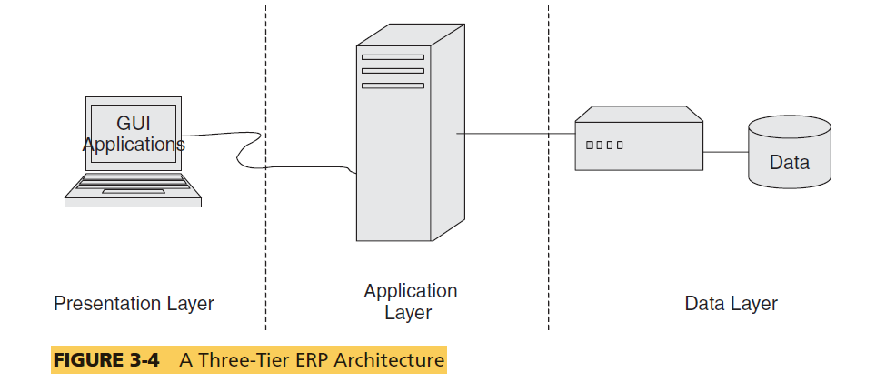
Diagram Three-tier App

Slide 11
Web(internet based) Services Architectures [4th tier]
This is often described as a fourth tier where the Web tier is split into services tier and browser tier . The ERP systems focus on the Internet to provide a powerful new functionality for Internet-based access and integration.
This functionality is primarily supported through the following Internet access technologies:
• Web server
• ERP portal
• Back-end server integration
• Browser plug-ins or applets
The Internet architecture can be server-centric or client-centric.

Slide 12
Continue…
In server-centric environments, clients only need access to the Internet and a standard browser (e.g., Internet Explorer or Firefox) with a few plug-ins (e.g., Java Virtual Machine and others). There are no other user interface applications required on the client; therefore, the client can be any Internet device that uses such standard Internet technologies as hypertext transport protocol or hypertext markup language (HTML) for user access, or extensible markup language for back-end communication between an application and a third-party system with the Internet application server.
In client-centric environments, client devices will need installation of software development kits (SDKs) and proper configuration and integration with client devices for the application to work properly. This is practically disappearing from PC-based clients due to the advantages provided by server-centric environments as well as due to higher network bandwidth and reliability. Client-centric platforms are popular in such other devices as personal digital assistants (PDAs), Blackberries, and mobile phones that are increasingly used to access information from the enterprise systems.

Slide 13
BENEFITS AND DRAWBACKS (Web)
Benefits :
The key benefit of using the Internet platform as the foundation is that organizations are able to provide a wide range of end users with access to ERP applications over the Web as well as more easily integrate their ERP applications with existing internal systems and external trading partner systems.
The Internet architecture can be server-centric (No installations , easy & inexpensive access , security) or client-centric(better response time).
This functionality is supported through the following Web technologies:
• Application messaging
• Component interfaces
• Business interlinks
• Application engine

Slide 14
Service-oriented architectures
It represents object-oriented architectures for Web platforms.
A service is a function that is well defined, self-contained, and does not depend on the context or state of other services.(distributed component object model (DCOM),Extended version of DCOM)
From an ERP perspective SOA decomposes the business tier into smaller, distinct units of services. These services collectively support an ERP functional module.
SOA allows message interaction between any service consumer and service provider.(follow SOA standards)
The SOA standard includes a description language for all functions or services that have active programming services that are called on to perform business processes.

Slide 15
Specification of SOA
SOA is a software development model based on a contract between a consumer (client) and a provider (server) that specifies the following:
Functional description of the service
Input requirements and output specifications
Precondition environment state before service can be invoked
Post condition environment state after service executed
Error handling when there is a breakdown

Slide 16
Benefits of SOA
SOA offers the following benefits over traditional approaches to distributed computing:
• Business-level software services across heterogeneous platforms
• Complete location independence of business logic
• Services can exist anywhere (i.e., any system and any network)
• Loose coupling across application services
• Granular authentication and authorization support at service unit level
• Dynamic search and connectivity to other services

Slide 17
Drawbacks of SOA
SOA requires:
System environment consisting of numerous complex structures for integration
SOA implementations, which are costly and time consuming
Maintenance environment to support rapid integration capability within these structures.
Organizational culture that embraces the rapid sharing of assets and information.
Management approaches to support rapid sharing and integration
Complex security firewalls in place to support communication between services across applications that traverse the organization’s networks.

Slide 18
Cloud Architecture
The cloud computing platform provides a great alternative for the organizations as they do not have to purchase, install, or maintain the software applications, nor do they have to worry about security, privacy, and legal issues associated with data storage.

Slide 19
Cloud Computing
Benefits to cloud computing:
Pay for subscription, not for licenses and upgrades
Reduced capital and operating expenditures for IT equipment and support personnel
Accessed from everywhere, as long as you have an Internet connection
No need to install anything on the user’s computer
Dynamic scalability available on demand
No maintenance fees for software or hardware
Promotes green computing environment as servers in cloud run on clean energy
Guaranteed reliability.
Drawbacks to cloud computing:
Data security
Vulnerability (Attack possible)
Possible conflict of interest, if the company who stores your applications decides to create a similar application to what you created on their servers
Not suited for all highly competitive industries like biotech where intellectual property(idea , invention) cannot be protected easily.

Slide 20
IMPLICATIONS FOR MANAGEMENT
Enterprise architecture is an important technology for the long-term functioning of the organization.
ERP architecture decisions are complex because their impact goes beyond systems and technology to people, organizational policy, and business processes.
ERP architecture must be flexible to support a diverse set of hardware and software platforms.
Do not get carried away with ERP technology hype.

